Slide 1

Weather Reporting System
nnamdi elijah Obi
Patrick Nonki
George izuchukwu Enekwa
Abdul-azeez olanlokun

Slide 2
MOTIVATION AND CONCEPT
WHY ARE WE DOING…?
WHAT ARE WE DOING…?
HOW ARE WE DOING…?

Slide 3
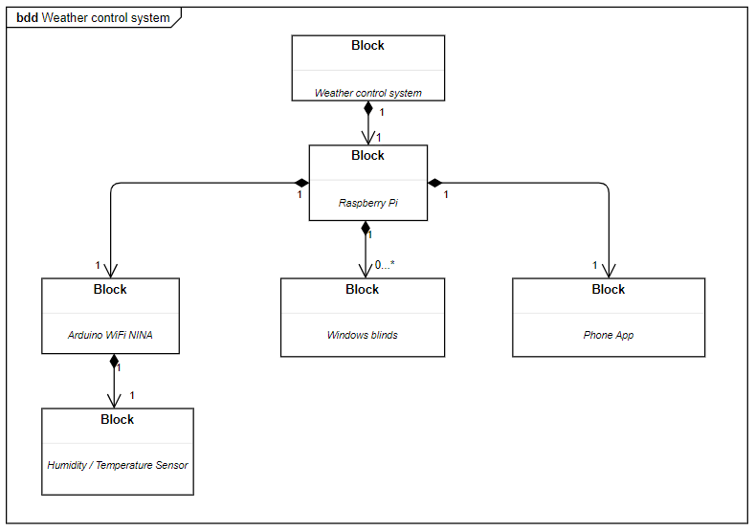
MODEL (UML BLOCK DIAGRAM)
ANSWERING THE HOW?

Slide 4
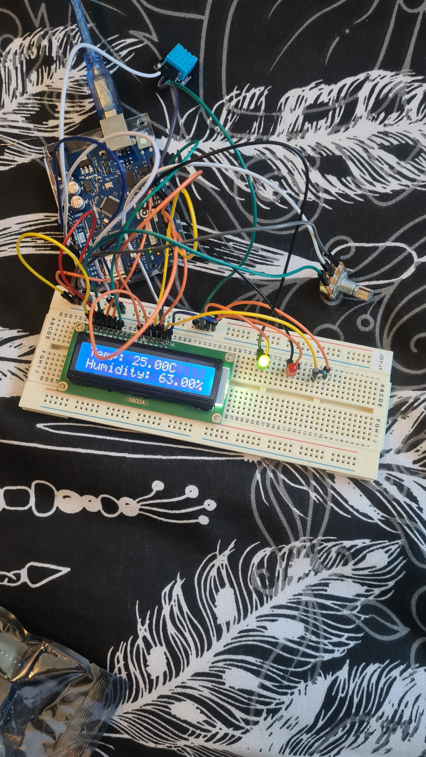
IMPLEMENTATION : SET-UP
Installation of OS on the RasberryPI
Setting up the static IP address
Installation of Mosquito
Hardware configuration on the breadboard
Setting up the app as a subscriber

Slide 5
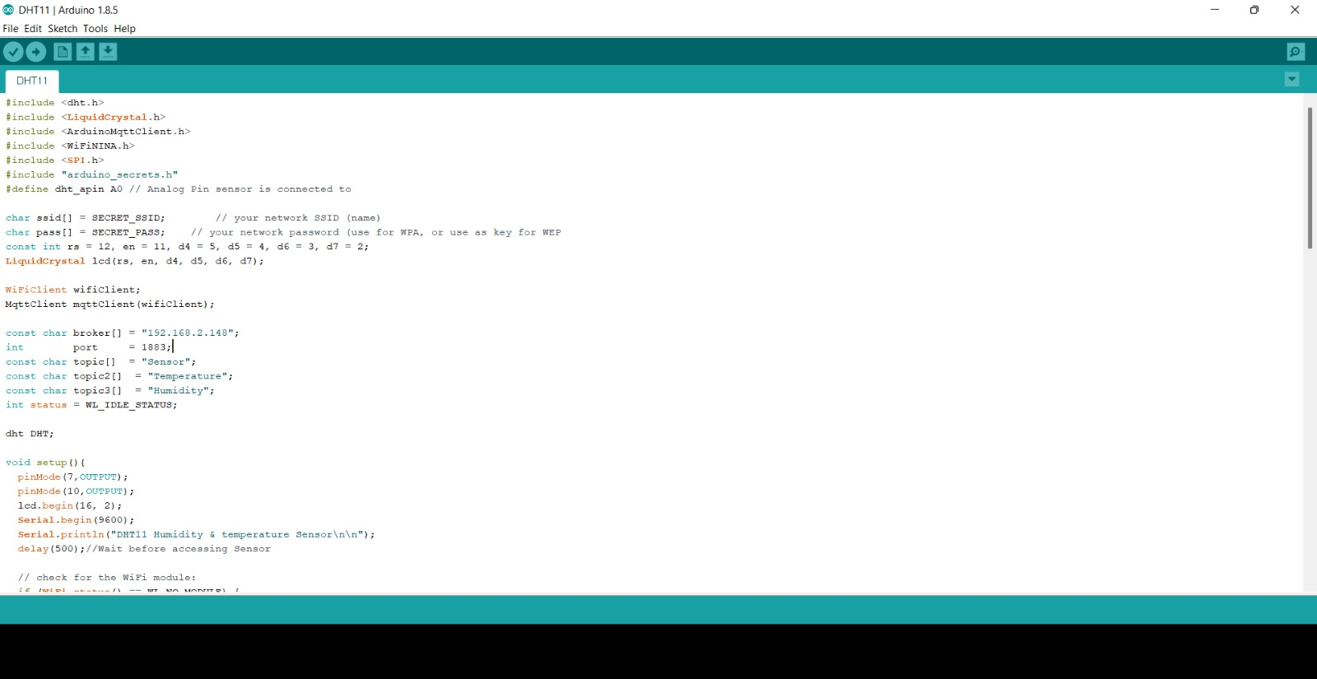
IMPLEMENTATION : CODE

Slide 6
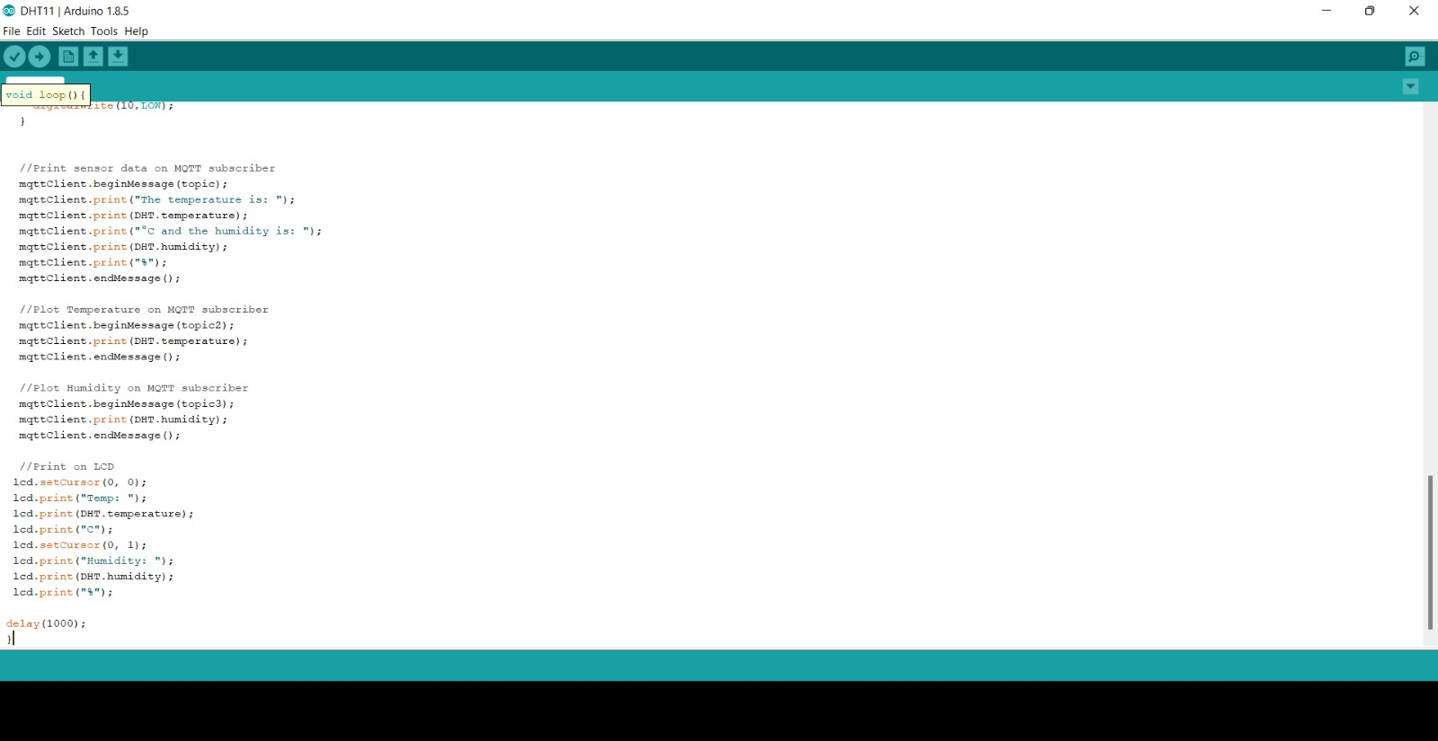
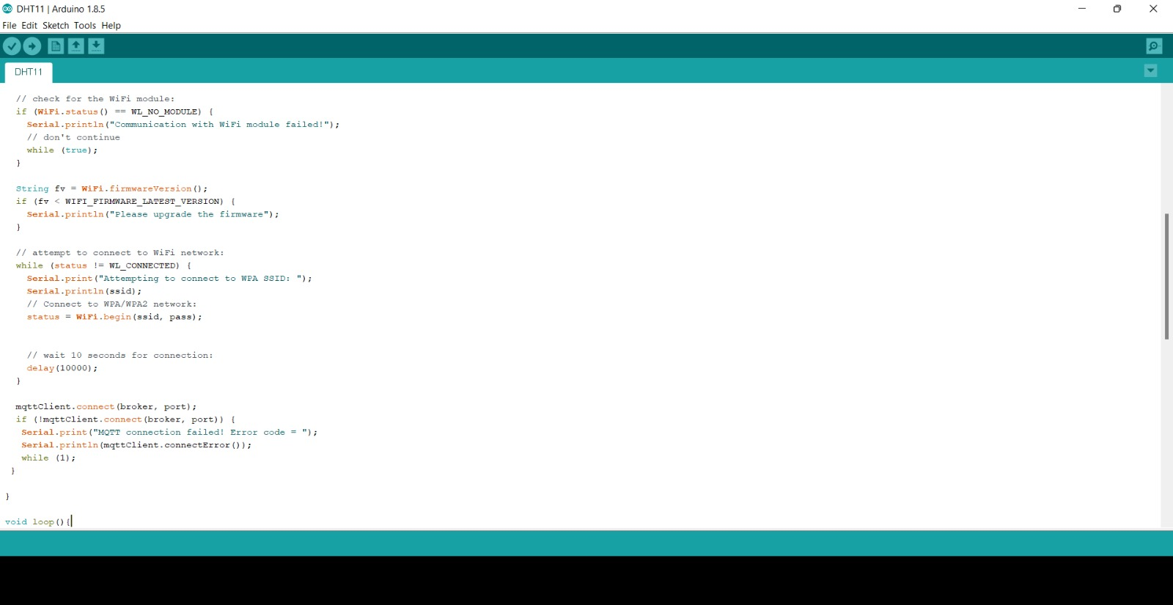
IMPLEMENTATION : CODE

Slide 7
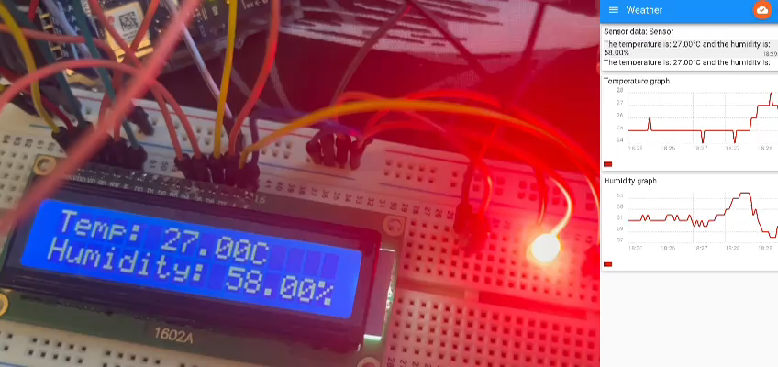
SIMULATION VIDEO

Slide 8
CONCLUSION
What we’ve been able to realize
Further implementation and use cases

